Slide 1
THE DESIGN PHASE OF THE MMS
Group two, Instructor :DR NKEMENI VALERY

Slide 2
THE DESIGN PHASE
The design phase consists of two stages:
A preliminary stage where the high-level design or architecture of the interactive system is derived:
A detailed stage, where the specifics of each interaction are planned

Slide 3
Preliminary design
It consists of mapping out the high-level concepts such as the user, controls, interface displays, navigation mechanisms, and overall workflow. Preliminary design can also be called conceptual design, particularly in software engineering, because it is sometimes useful to organize the high level concepts into a conceptual map with their relations. It consist of the use case and class diagrams of the system.

Slide 4
Preliminary phase
Use Case diagram
Consist of the following
Actors
Use cases
Relationship between them

Slide 5
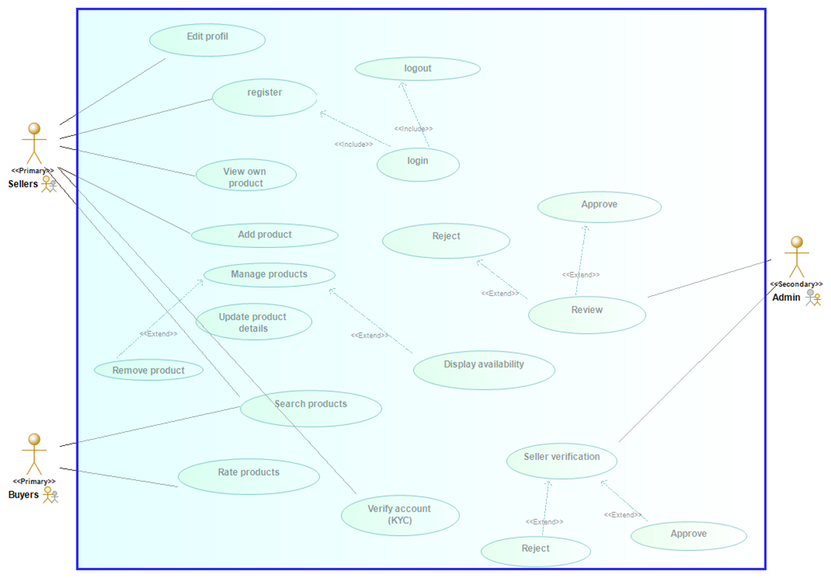
Use case diagram

Slide 6
Preliminary phase
Class diagram
Consist of the following
Classes
Fields(Attributes)
Methods

Slide 7
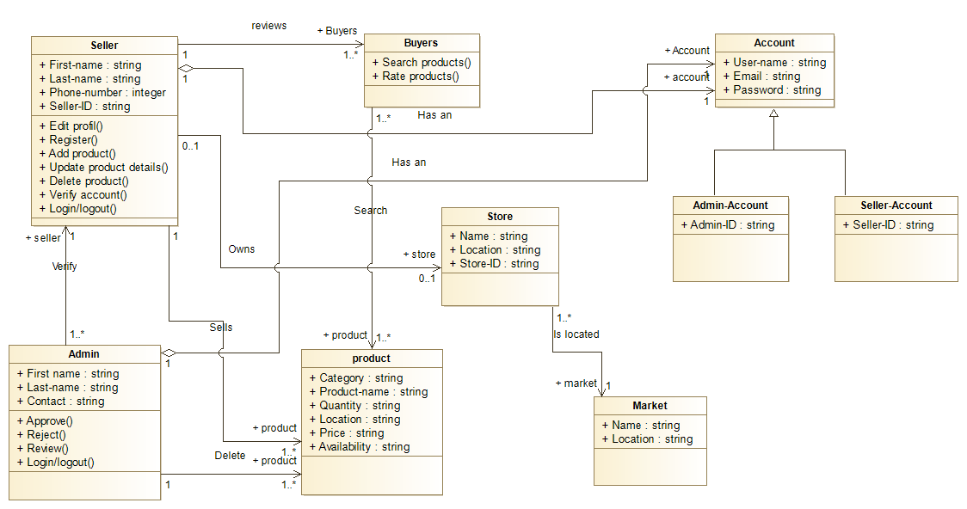
Class diagram

Slide 8
Detailed Design
This stage entails planning all the operations that take place between user and interactive system to a level where only implementation and technical details remain. It can be done by creating and refining a step-by-step list for the exchanges between the user and the system. Refinement of architectural components and interrelations to identify modules to be implemented separately. It consist of the sequence and flow diagrams of the system. All this is detailed in the UML (Unified Modelling Language diagrams) below which is modelled using the software Modelio.

Slide 9
Detailed Design
Activity diagram
Activity Diagrams describe:
How activities are coordinated to provide a service
The events needed to achieve some operation
How the events in a single use case relate to one another
How a collection of use cases coordinate to create a workflow for an organization
we have the seller account verification, seller mage product and product search and product view diagrams

Slide 10
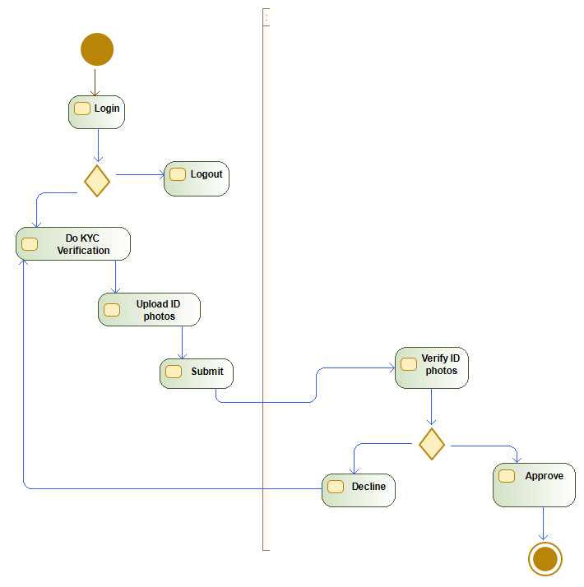
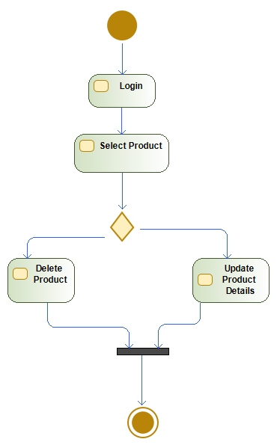
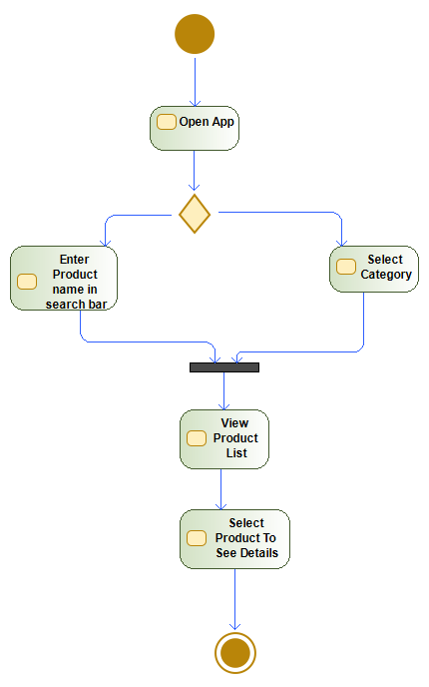
Activity diagram

Slide 11
Detailed Design
B. Sequence Diagram
The sequence diagram shows the flow of information of each use case in the system
We list a few of the diagrams in this document, Manage product and Update profile sequence diagram.

Slide 12
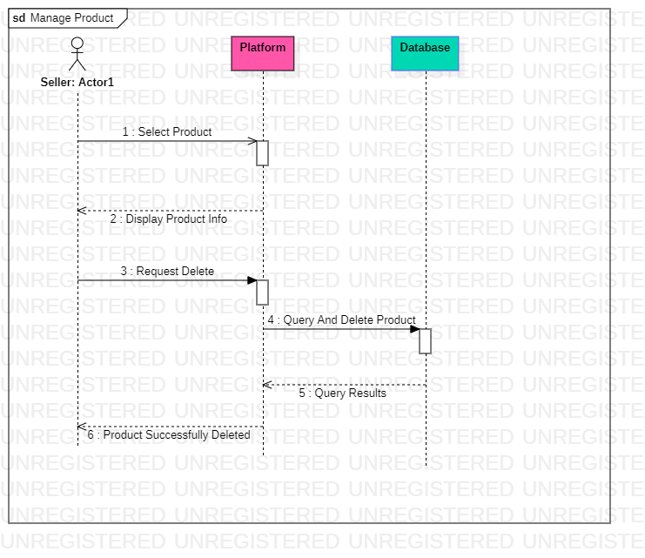
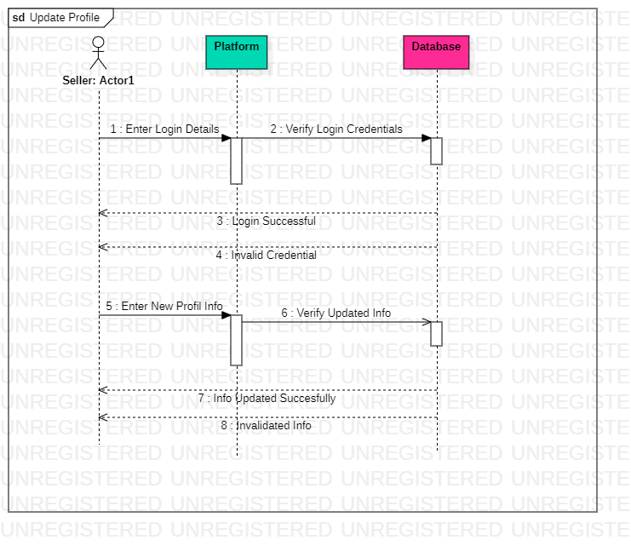

Sequence diagram

Slide 13
Detailed Design
C. Flow diagram
The data flow diagram is a flowchart that shows the flow of data in a system. In our system, the data flow diagram model the product as the data, the users as the seller, customer and admin.

Slide 14
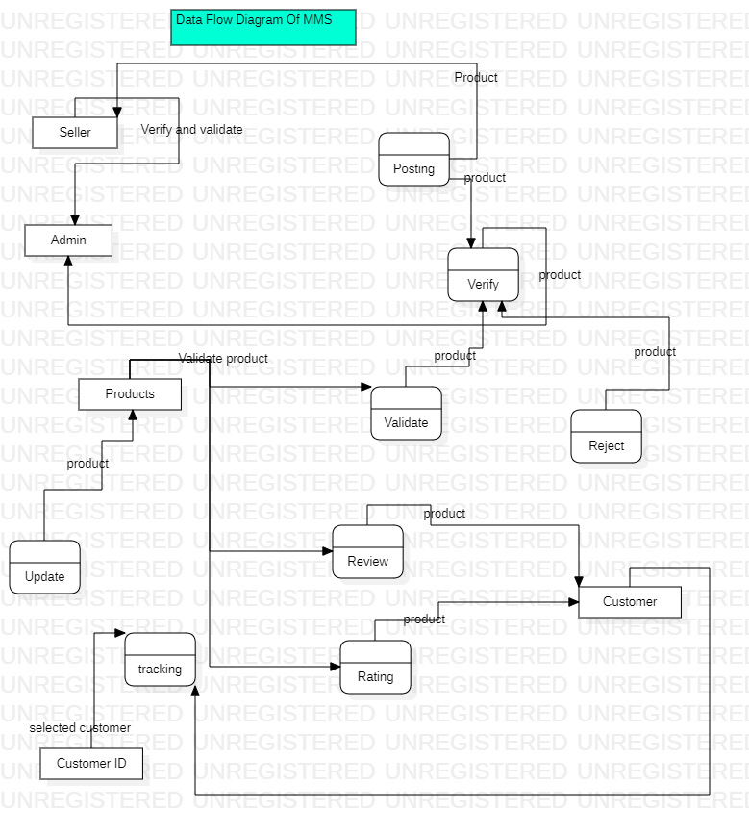
Flow diagram
Flow diagram

Slide 15
THANK YOU
PRESENTED BY GROUP TWO

